Slide 1
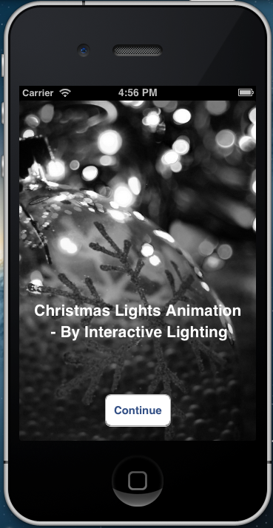
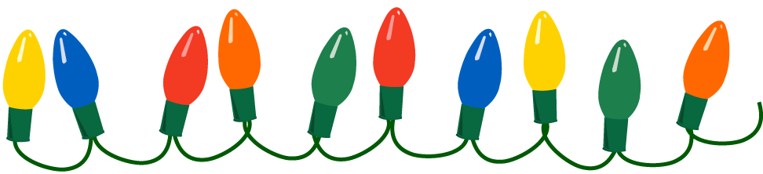
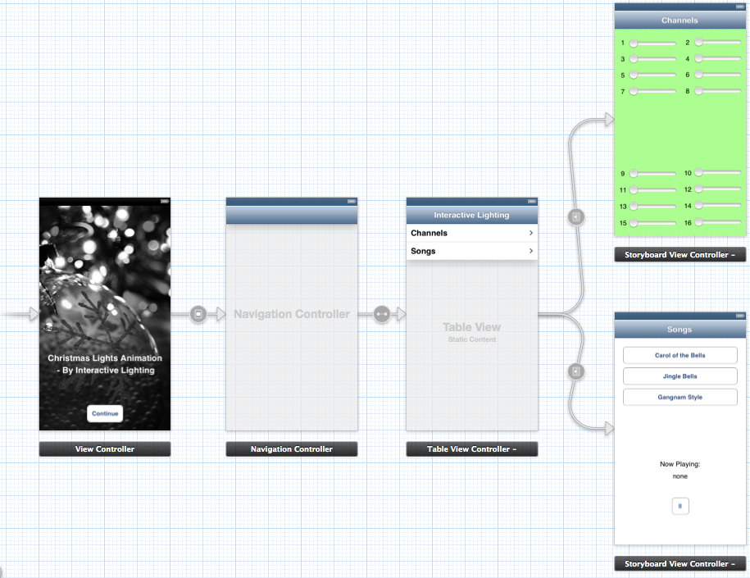
Christmas Lights Animation By: Austin Wentz and Jordan Doell
iOS Application
Server
Hardware
iPhone® app
“Controls the system”
Sends commands to the server
Play a song
Pause a song
Can change each channel’s brightness
Sends commands using JSON data format
Stuff about the server
??diagram of system from app to server to hardware
Hardware information and pictures

